Slide 1






PRESENTATION 2026
Student Name
Student Email
Aditi Singh
aditizasha@gmail.com
Mentor Name
Abdul Aziz Md

Slide 2

Outline
Abstract of the Project
Problem Statement
Proposed Solution
System Architecture
Live Demo of the Project
Embedded Video of Project
Conclusion
Future Scope

Slide 3
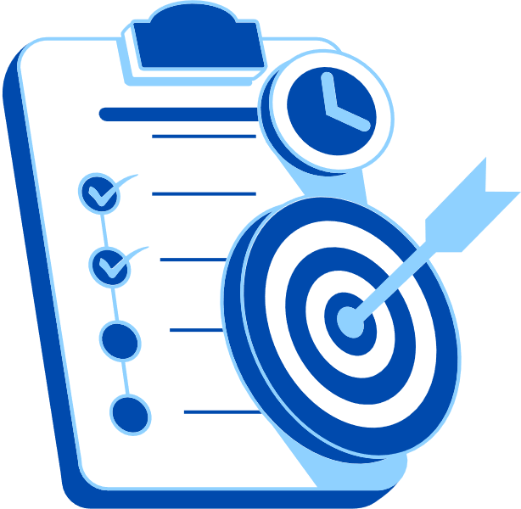
Abstract
This project focuses on analyzing banking customer data using AI-powered tools and data visualization.
The objective is to monitor customer financial health, identify high-risk and inactive accounts, and track loan exposure.
Tools used: Microsoft Excel, Power BI, ChatGPT, and Microsoft Copilot.
The project delivers an interactive dashboard for better decision-making and risk management.
Key highlight: AI-assisted insights for identifying financial patterns and improving customer engagement.

Slide 4

Problem Statement
Banks generate massive customer data but it is underutilized due to lack of centralized analysis.
Difficulty in identifying inactive accounts and high-risk customers.
Challenges in tracking loan exposure and customer segmentation.
Lack of tools to monitor financial health and detect unusual activity.
Existing systems do not provide actionable insights for decision-making.

Slide 5

Proposed Solution
Develop an AI-driven dashboard using Power BI for customer analytics.
Clean and preprocess data using Excel.
Analyze customer activity, loan exposure, and risk levels.
Use AI tools (ChatGPT, Copilot) to generate insights and recommendations.
Provide a centralized system for better financial monitoring and decision-making.

Slide 6
System Architecture
Data Input / Source
Processing / Analysis
Simulated dataset of 1600 ICICI Bank customers.
Data cleaning and preprocessing using Excel.
Analysis using Power BI.
AI / Tool Integration
Output / Dashboard
ChatGPT and Microsoft Copilot for insights.
Power BI for visualization.
Interactive dashboard with KPIs, charts, and customer insights.

Slide 7
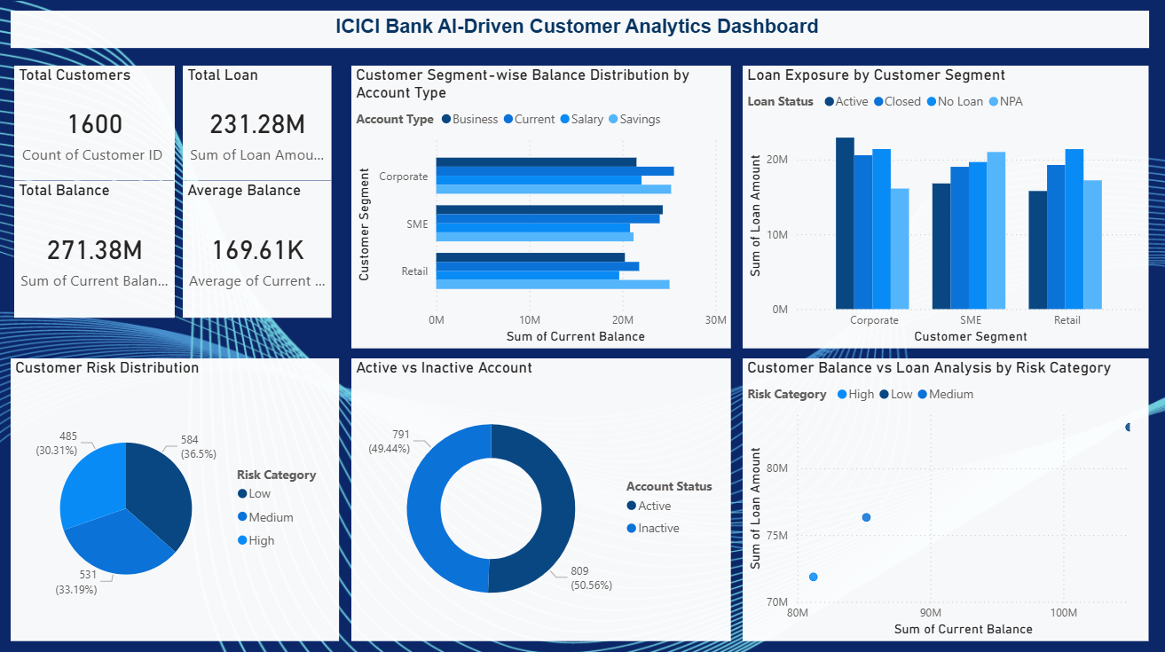
Live Demo of Project
Here's the list of some demo screenshots / features of the project:
Demo 1 Dashboard Overview
Displays a comprehensive Power BI dashboard with key performance indicators such as total customers, total current balance, total loan amount, and average balance.
Provides insights into customer segmentation, loan exposure, risk distribution, and account activity (active vs inactive).
Enables quick analysis of customer financial health and supports data-driven decision-making for banking operations.

Slide 8
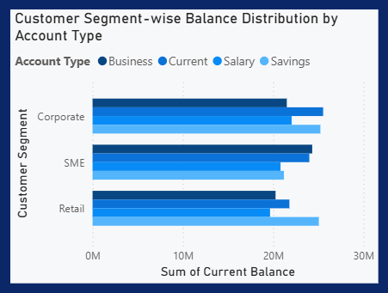
Live Demo of Project
Here's the list of some demo screenshots / features of the project:
Demo 2 Customer Segment-wise Balance Distribution by Account Type
Customer Segment-wise Balance Distribution by Account Type.
Shows distribution of current balance across different customer segments (Corporate, SME, Retail) and account types (Business, Current, Salary, Savings).
Helps identify which customer segment and account type contribute the most to total balance.
Provides insights into customer financial behavior for better segmentation and targeting.

Slide 9
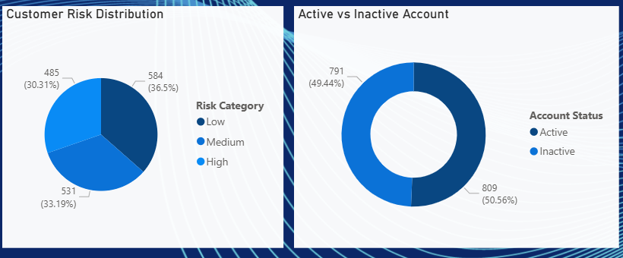
Live Demo of Project
Here's the list of some demo screenshots / features of the project:
Demo 3 Customer Risk Distribution & Active vs Inactive Account Analysis
Displays the distribution of customers across different risk categories (Low, Medium, High) with percentage representation.
Shows active and inactive account status to identify customer engagement levels.
Helps in identifying high-risk and inactive customers, supporting better risk management and retention strategies.

Slide 10
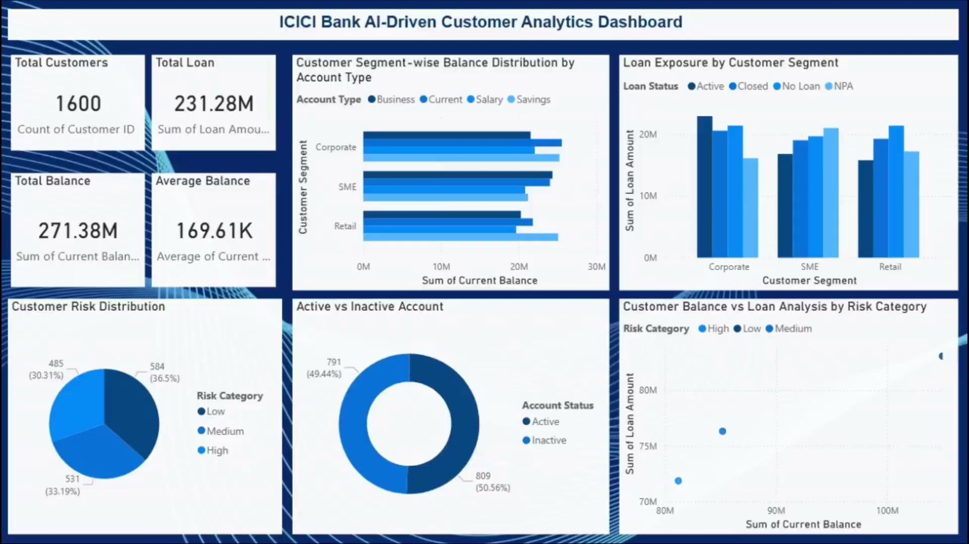
Video of Project Demo
[https://your-project-demo-link.com]
▶
[Insert your project demo video.
You can embed a video your live project.]

Slide 11

Conclusion
The project successfully developed an AI-driven dashboard for banking analytics.
It helps identify high-risk customers and inactive accounts.
Provides insights into loan exposure and customer financial health.
Supports better decision-making and risk management.
Project objectives were successfully achieved.
CONCLUSION

Slide 12

Future Scope
Integration with real-time banking data.
Use of machine learning for risk prediction.
Advanced fraud detection systems.
Personalized banking recommendations.
Cloud-based deployment for scalability.

Slide 13
Thank You
AICW Fellowship | Student Project Presentation 2026
LinkedIn | Edunet Foundation

